Slide 1
Boston Venues Analysis
A coursera project
By Lynn

Slide 2
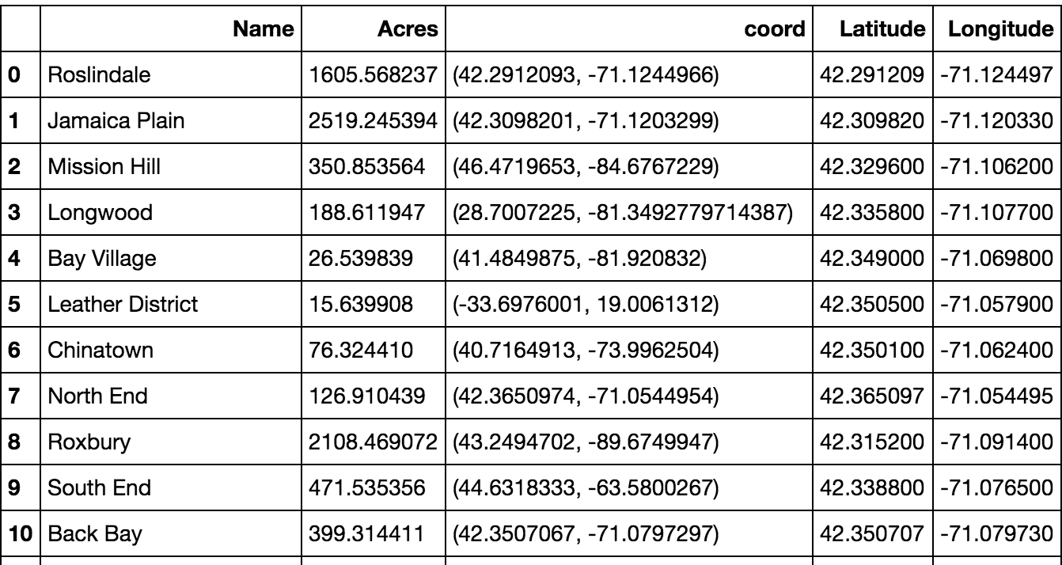
Introduction Initial data is from Analyze Boston with neighborhood boundaries—see below for the cleaned dataframe

Slide 3
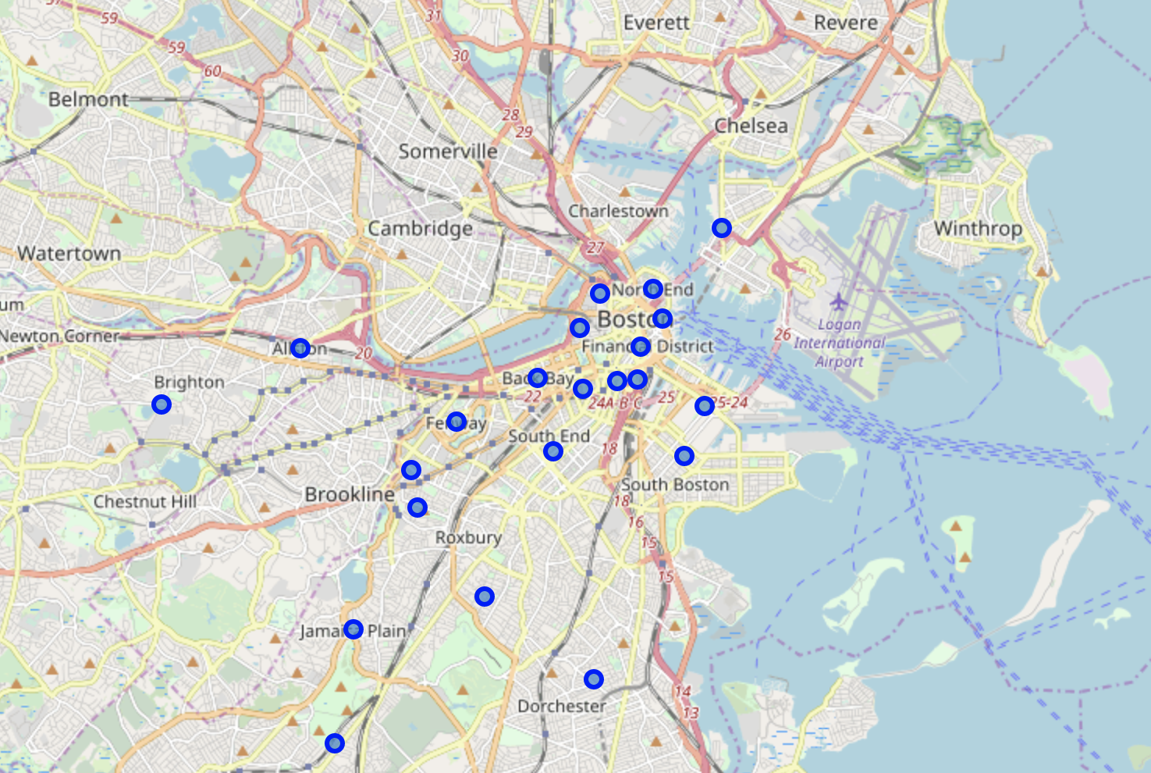
Create a Folium map with 26 neighborhood superimposed on top to visualize

Slide 4
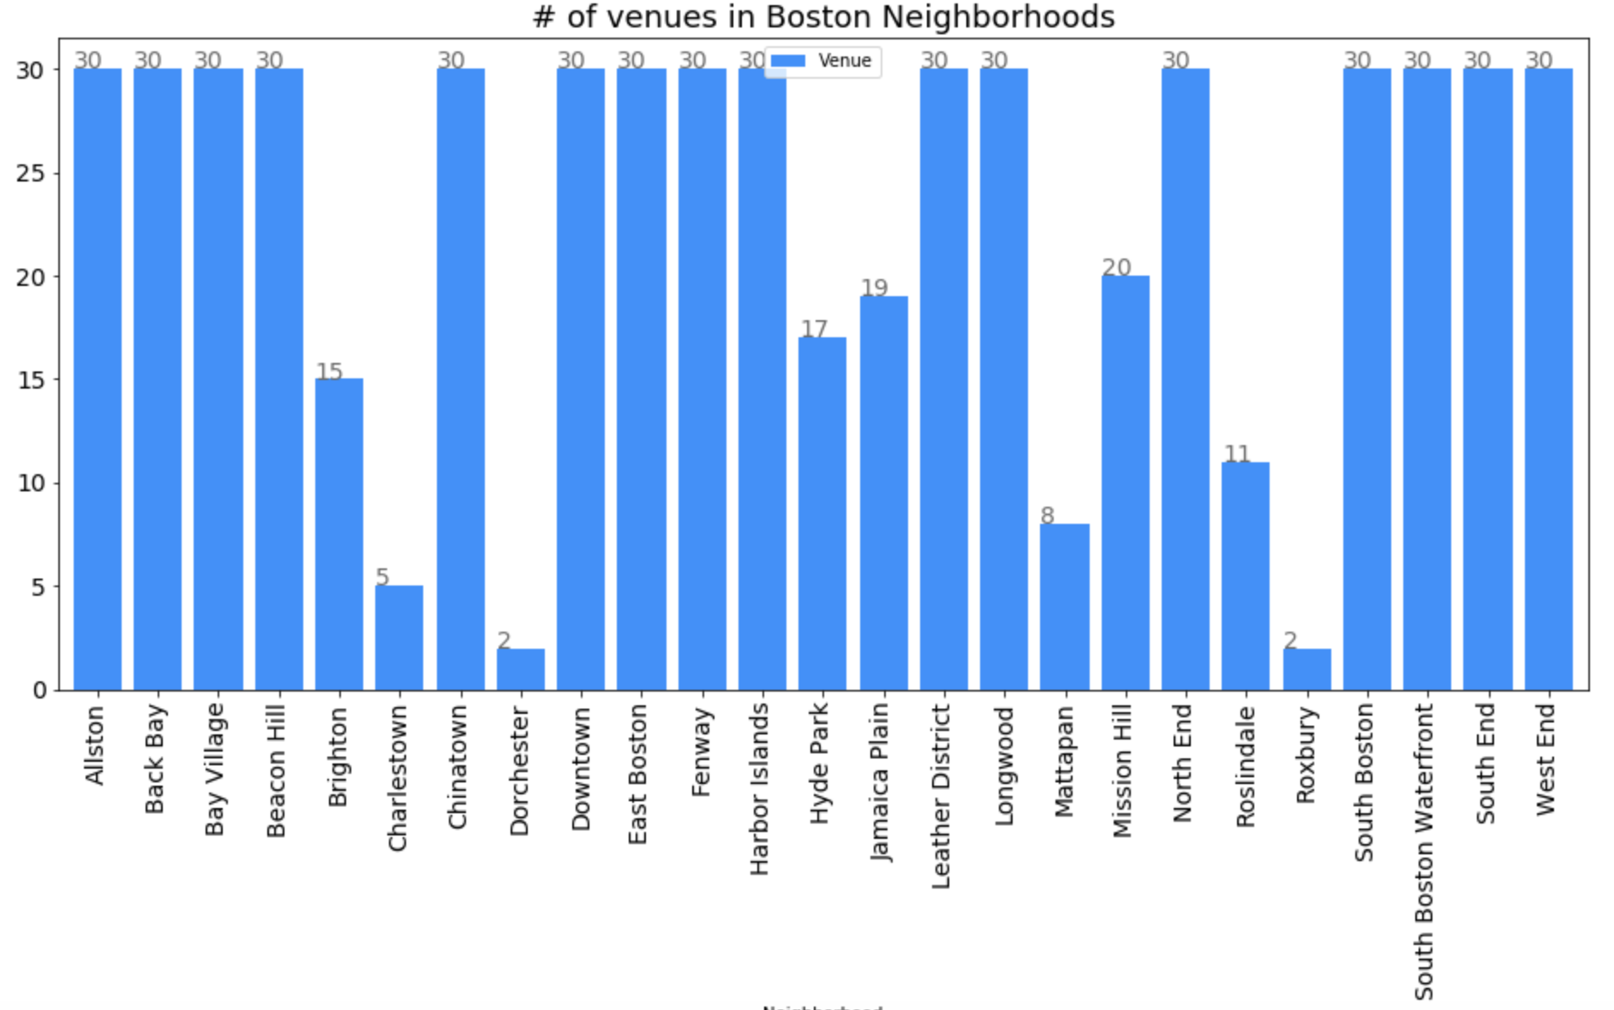
Used Foursquare API to get the venue data of neighborhoods in Boston Performing EDA analysis by summarizing the data Note Allston, Back Bay are the more popular choices in terms of venues density

Slide 5
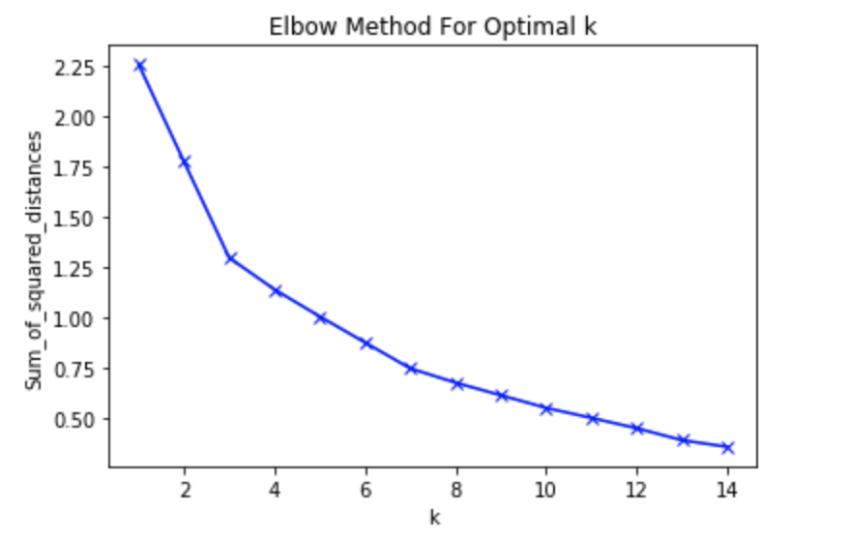
K-means clustering to group neighborhoods by venue density
Use sklearn.cluster Kmeans library
Use elbow method for k cluster determination (given the elbow is not particularly obvious for this case, choose 7 for number of clusters for segmentation)

Slide 6
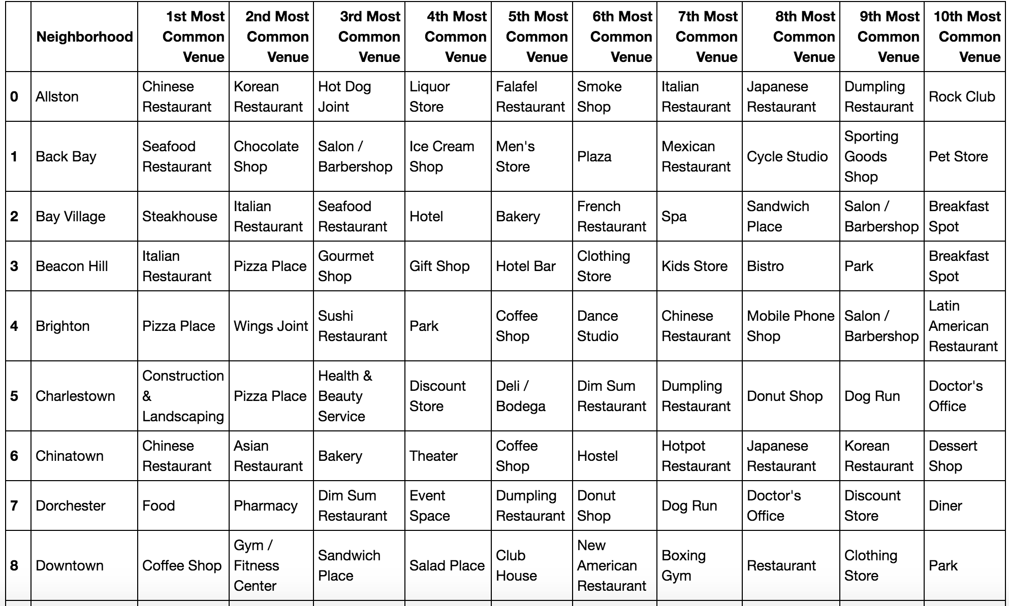
See chart for the resulting dataframe for the top 10 most common venues by neighborhood

Slide 7
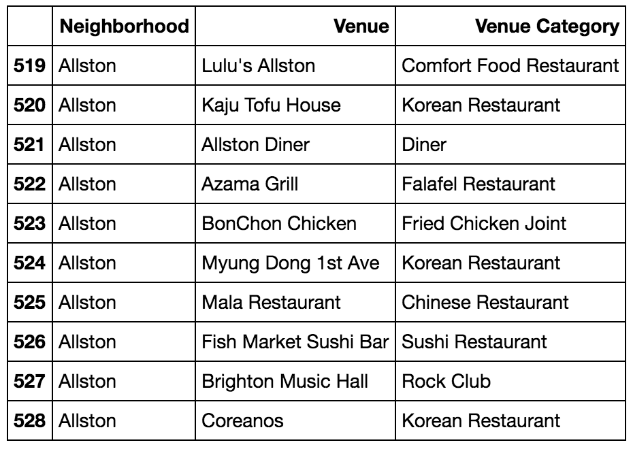
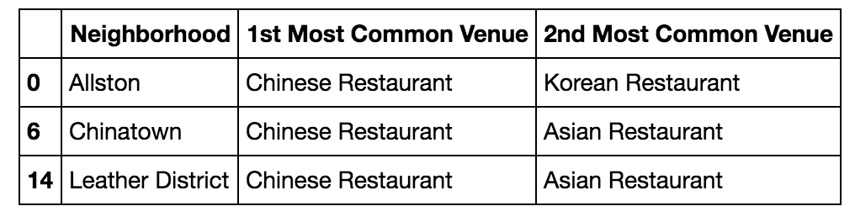
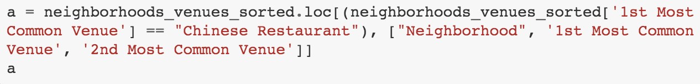
Applying to real business problems-informing a decision to open a new restaurant
Who are my main competitors in Allston if I open the restaurant there?
If I want to open a Chinese restaurant, where are the possible places where this venue is most popular?

Slide 8
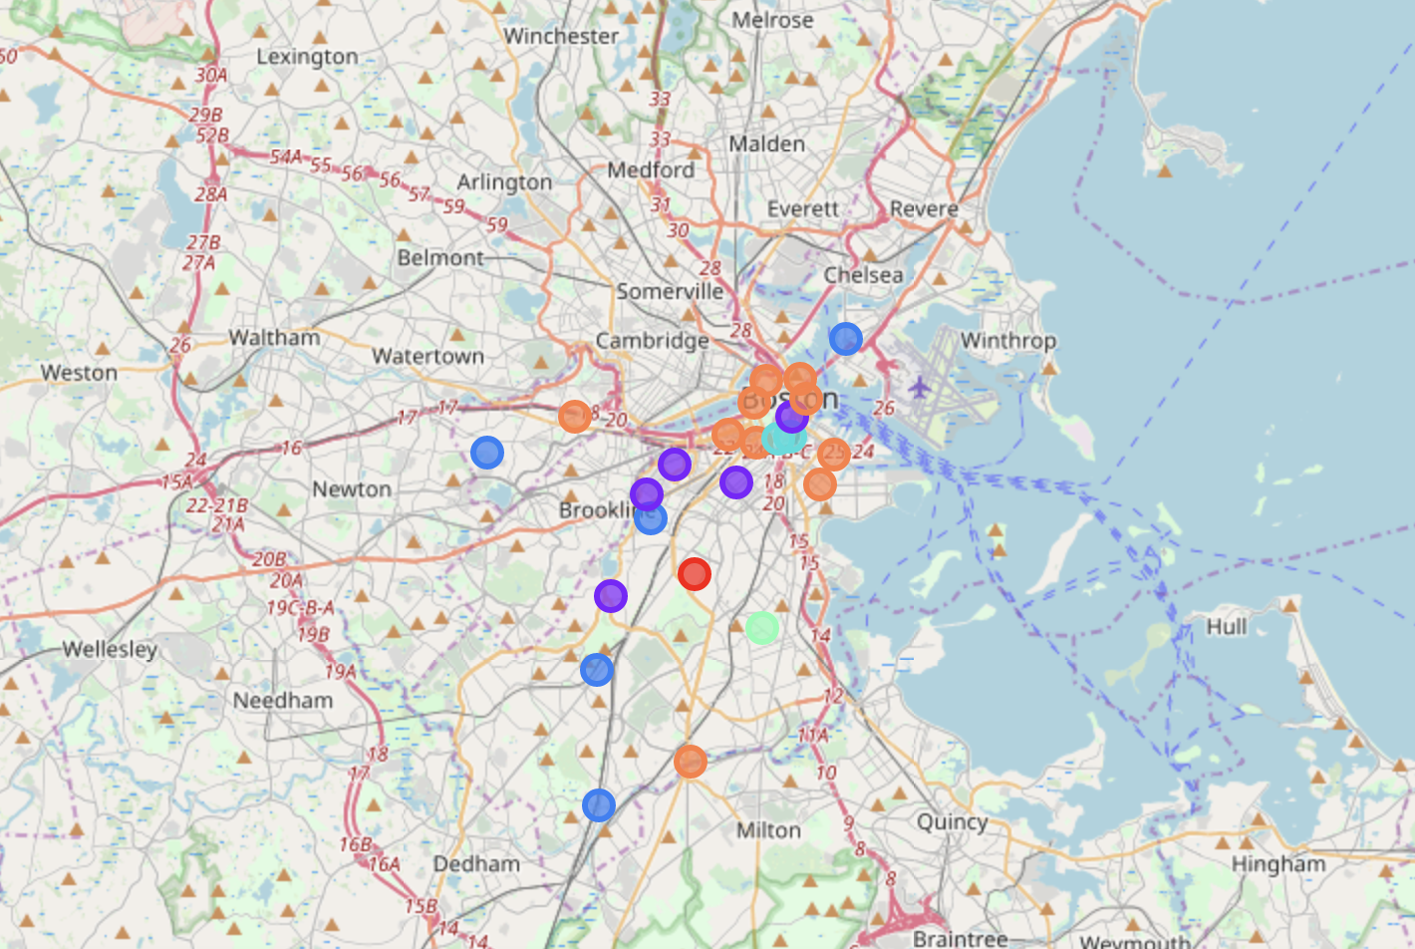
Finally, visualize the resulting clusters with color codes corresponding to the cluster labels, using a folium map

Slide 9
Thank you for viewing!
This is the end of the project

